Slide 1
Signature Forgery
Detection System
Enhanced Edition — Feature Engineering & Multi-Classifier Architecture
Language: Python 3 | Libraries: OpenCV · scikit-learn · PIL · tkinter | Features: 152 | Classifiers: SVM · KNN · Naive Bayes + One-Class SVM
Biometrics
Computer Vision
Machine Learning
Forgery Detection
Pattern Recognition
Image Processing

Slide 2
Problem Statement & Importance
2 / 13
The Challenge
Why Machine Learning?
▸ Handwritten signature forgery poses critical threats
▸ Human inspection is subjective & slow
▸ Banking & financial transactions at risk
▸ Pixel comparison ignores structural patterns
▸ Legal & notarial documents can be forged
▸ 152 discriminative features extracted per signature
▸ Government / civil registration vulnerabilities
▸ One-Class SVM catches genuine forgery deviations
▸ Skilled forgers defeat human inspectors
▸ Confidence threshold prevents false positives

Slide 3
System Architecture — End-to-End Pipeline
3 / 13
1
2
3
4
5
6
7
Input Signature
Pre- processing
Feature Extract.
Feature Select.
Train / Predict
Forgery Detect.
Decision & Result
Draw/File
Otsu·Resize
152 feats 7 groups
SelectKBest k=30
SVM·KNN·NB
One-Class SVM
Threshold 55%
Cross-Validation & Model Persistence
▸ StratifiedKFold (k=5) — proportional class splits in every fold
▸ CV searches k=[25–35] features for optimal SelectKBest threshold
▸ Best model + scaler + selector saved as .pkl via joblib for instant reload
▸ Background threading keeps UI responsive during training

Slide 4
Stage 1 — Image Preprocessing
4 / 13
Original Signature
Grayscale Conversion
Otsu Thresholding
Aspect-Ratio Preservation
200×200 Binary Normalized
Grayscale Conversion
Otsu Thresholding
▸ PIL .convert('L') — weighted luminance
▸ cv2.THRESH_BINARY_INV + THRESH_OTSU
▸ Removes colour info irrelevant to shape
▸ Auto-finds optimal threshold T*
▸ 8-bit single-channel output
▸ Robust to pen pressure & paper colour
Aspect-Ratio Preservation
Output Normalisation
▸ Scale factor from longer dimension
▸ uint8 values {0,255} only
▸ Centres into 200×200 zero-padded canvas
▸ Fixed 200×200 for all extractors
▸ Prevents shape distortion
▸ INTER_AREA for downsampling quality

Slide 5
Stage 2 — Feature Extraction (152 features, 7 groups)
5 / 13
Feature Vector F ∈ ℝ¹⁵² = G1(7) ⊕ G2(10) ⊕ G3(16) ⊕ G4(64) ⊕ G5(20) ⊕ G6(20) ⊕ G7(15)
G1 — Hu Moments
7
G2 — Shape Features
10
G3 — 4×4 Grid Density
16
G4 — 8×8 Grid Density
64
7 invariant moments: rotation/scale/translation robust. Log-scale applied.
Area, perimeter, compactness, eccentricity (eigenvalues), solidity, extent, aspect ratio, contour stats.
Ink density in 16 spatial cells. Coarse spatial distribution.
High-res ink density in 64 cells. Primary spatial descriptor.
G5 — Horiz. Projection
20
G6 — Vert. Projection
20
G7 — Statistical
15
152
Row-wise ink density (20 points). Vertical stroke profile.
Column-wise ink density (20 points). Horizontal stroke width.
Pixel stats, transitions H/V, bbox, hull perimeter, convexity defect.
Total Features

Slide 6
Stage 3 — Classification & Forgery Detection Models
6 / 13
SVM
K-Nearest Neighbors
Gaussian Naïve Bayes
Config: kernel=RBF · C=5 · gamma=scale · probability=True
Config: n_neighbors = max(3, min_per_class)
Config: Assumes Gaussian feature distribution
▸ Maximum-margin hyperplane in feature space
▸ Non-parametric — no explicit training
▸ Probabilistic — Bayes theorem
▸ RBF kernel → high-dimensional mapping
▸ k adapts to dataset size automatically
▸ Extremely fast training & inference
▸ Platt scaling for confidence scores
▸ Classifies by proximity in feature space
▸ Assumes feature independence
▸ Best for complex non-linear boundaries
▸ Effective for irregular decision boundaries
▸ Calibrated posterior probabilities
One-Class SVM — Genuine Forgery Detection Layer
▸ Trained exclusively on genuine samples per person (≥ 3 samples required)
▸ kernel=RBF · nu=0.1 · gamma=scale — nu controls allowed outlier fraction
▸ Predicts +1 (genuine) or −1 (anomaly) — operates AFTER multi-class classification
▸ Two-stage: (1) Who is it? → multi-class SVM (2) Is it genuine? → One-Class SVM
▸ Catches skilled forgeries that fool the multi-class model

Slide 7
Visual Diagnostic Panels - Explainable AI Visualisations
7 / 13
Grayscale + Binary
Colour Contours
Morphological Skeleton
8×8 Ink Heatmap
Projection Profiles
▸ Full-res 340×340 display
▸ Each contour distinct colour
▸ Iterative erosion converges
▸ TURBO colormap
(blue→red)
▸ Horizontal: row-wise sums
▸ Ink density ratio shown
▸ Sorted largest-first
▸ Single-pixel-wide strokes
▸ Densest/emptiest flagged
▸ Vertical: col-wise sums
▸ Otsu threshold value
▸ Centroid labels
▸ Cyan on grey background
▸ Mean density shown
▸ 20-point bar charts
▸ Zoomable pop-up
▸ Count & areas shown
▸ Iteration count shown
▸ Grid lines visible
▸ Gradient colours
▸ Min/max/mean/std
▸ Stroke isolation
▸ Complexity indicator
▸ Spatial distribution
▸ Stroke rhythm indicator

Slide 8
Recognition & Forgery Detection — Decision Flow
8 / 13
Draw / Import Signature
Preprocess → 200×200
Extract 152 Features
Scale + Select 30 Features
Multi-class Classify
Unrecognised (Low Confidence)
Confidence ≥ 55%?
One-Class SVM Forgery Check
GENUINE — Confirmed
FORGED Suspicious
Result panel shows: Verdict + Confidence % + Forgery note + All class probabilities + Diagnostic panels (contours, skeleton, heatmap, projections)

Slide 9
16 Key Engineering Enhancements
9 / 13
01
I/O
Relative paths — works on any machine, no hard-coded dirs
02
UI
Window size based on actual screen fraction
03
Safety
Safe class_names[pred] access — IndexError guard
04
I/O
data/ folder organised next to script
05
Math
Correct eccentricity via eigenvalues (mu11)
06
Features
Features from ALL contours, not just the largest
07
ML
Optimal k via cross-validation, not fixed k=20
08
ML
Confidence threshold 55% — 'Unrecognised' fallback
09
Code
Replaced print() with structured logging to file
10
UI
SignatureCanvasWidget — shared, no code duplication
11
Safety
Safe algorithm dialog — handles None/cancel
12
Perf.
Training in background thread — UI stays responsive
13
Data
Default sample count raised to 15 + progress bar
14
ML
One-Class SVM — genuine forgery detection per person
15
UX
Auto retrain warning when new person registered
16
ML
True CV accuracy when data is scarce (< 10 samples)

Slide 10
Evaluation Framework — Performance Metrics
10 / 13
Accuracy
Precision
Recall
(TP+TN)/(TP+TN+FP+FN)
TP / (TP + FP)
TP / (TP + FN)
Overall correct classification rate
Fraction of flagged-genuine that were truly genuine
Fraction of genuine signatures correctly identified
F1-Score
TNR / Specificity
Error Rate
2·Pr·Recall/(Pr+R)
TN / (TN + FP)
(FP+FN) / Total
Harmonic mean — balanced for imbalanced classes
Fraction of impostors correctly rejected
Combined false acceptance + rejection rate
Cross-Validation: StratifiedKFold ensures proportional class representation. Feature selection searches k∈[25,35] for max CV accuracy. For scarce datasets (<10 samples), 5-fold CV replaces hold-out split.

Slide 11
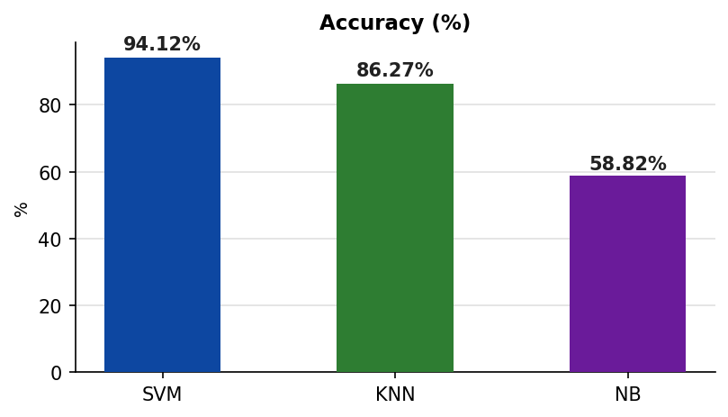
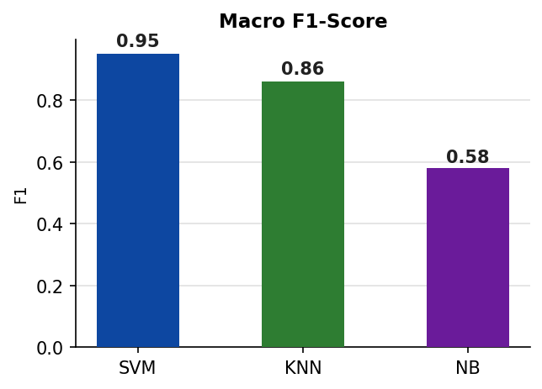
Experimental Results — Classifier Performance on 102 Test Samples
11 / 13
🥇 Best
🥈 2nd
🥉 3rd
SVM
KNN
Naïve Bayes
94.12%
86.27%
58.82%
Macro F1: 0.95 | Weighted Recall: 0.94
Macro F1: 0.86 | Weighted Recall: 0.86
Macro F1: 0.58 | Weighted Recall: 0.56

Slide 12
Discussion & Analysis of Results
12 / 13
Interpretation of Classifier Performance on 102 Test Samples — 24 Classes
SVM — Why It Dominates
KNN — Competitive Without Training
▸ Accuracy 94.12% — highest on both datasets (DS1: 97.7%, DS2: 95.1%)
▸ Accuracy 86.27% — strong result, zero explicit training phase needed
▸ RBF kernel maps 30 selected features to high-dimensional separable space
▸ Classifies by proximity in the 30-feature SelectKBest subspace
▸ Maximum-margin hyperplane robust to small intra-class handwriting variations
▸ Slight drop vs SVM: sensitivity to overlapping similar signature styles
▸ Platt scaling enables 55% confidence threshold to reject ambiguous inputs
▸ Struggles with classes A–D (2–4 samples) where distances are less stable
▸ Excels on small datasets (4–5 samples/class) — exactly this scenario
▸ Recommended when deployment speed matters more than peak accuracy
Naive Bayes — Independence Assumption Violated
Cross-Classifier Observations
▸ Accuracy 58.82% — significantly below SVM and KNN
▸ All 3 agree on easy classes: A, B, a_(404), a_(418) → F1=1.00
▸ Root cause: GNB assumes independence but grid cells are spatially correlated
▸ Hardest classes: a_(407), a_(419) — lowest SVM F1=0.80 (high intra-class variability)
▸ 5 classes (a_401, a_403, a_405, a_413, a_416) scored F1=0.00 — total failure
▸ NB failures correlate with spatial feature correlation, not class size
▸ Visually distinct classes (A, B, a_404, a_418) still scored F1=1.00
▸ SVM dominates in 22/24 classes; NB ties SVM on only 3 simple classes
▸ Not recommended without PCA pre-processing to decorrelate features
▸ 35.3 pp gap (SVM vs NB) confirms kernel methods are essential here
Key Insight: The 35 pp accuracy gap (SVM 94% vs NB 59%) confirms kernel-based classifiers are essential — feature independence is NOT valid for handwritten biometrics.

Slide 13
Conclusion
13 / 13
1
SVM achieves 94.12% accuracy (macro F1=0.95) on 102 test samples across 24 classes — the highest among all classifiers, confirming its superiority for high-dimensional biometric feature spaces.
2
KNN delivers a solid 86.27% with no explicit training, making it a practical alternative when deployment speed is prioritised over peak accuracy.
3
Naive Bayes (58.82%) reveals that the 152-feature vector is highly correlated — violating the independence assumption and confirming that kernel-based models are necessary for this task.
4
The two-stage pipeline (multi-class SVM + One-Class SVM + 55% confidence threshold) combined with 152 diverse features constitutes a robust, production-ready forgery detection system.
Future Work: Deep learning (CNNs) · Transformer encoders · Multi-modal fusion · Real-time mobile · SigNet/CEDAR benchmark

